Slide 1
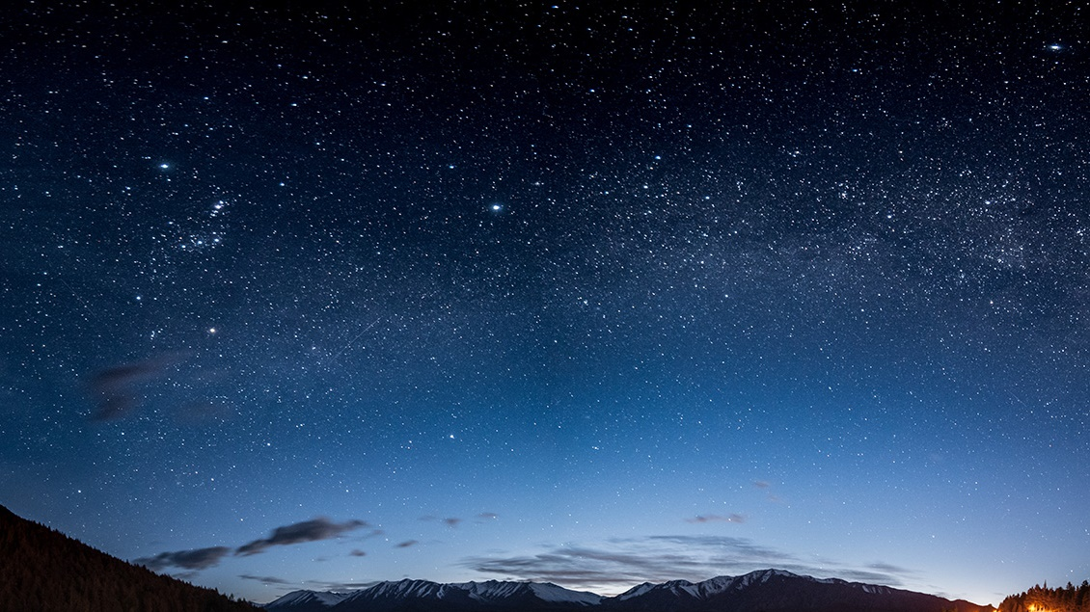
Light from the Sanctuary
Daniel 7-8, Hebrews 7-8
The Great Controversy Ch. 22, 23, 24, 28
Lesson 8, 2nd Quarter 2024

Slide 2
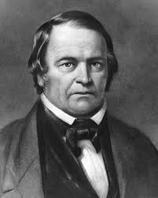
Daniel 8:13-14
Then I heard one saint speaking, and another saint said unto that certain saint which spake, How long shall be the vision concerning the daily sacrifice, and the transgression of desolation, to give both the sanctuary and the host to be trodden under foot?
And he said unto me, Unto two thousand and three hundred days; then shall the sanctuary be cleansed.

Slide 3
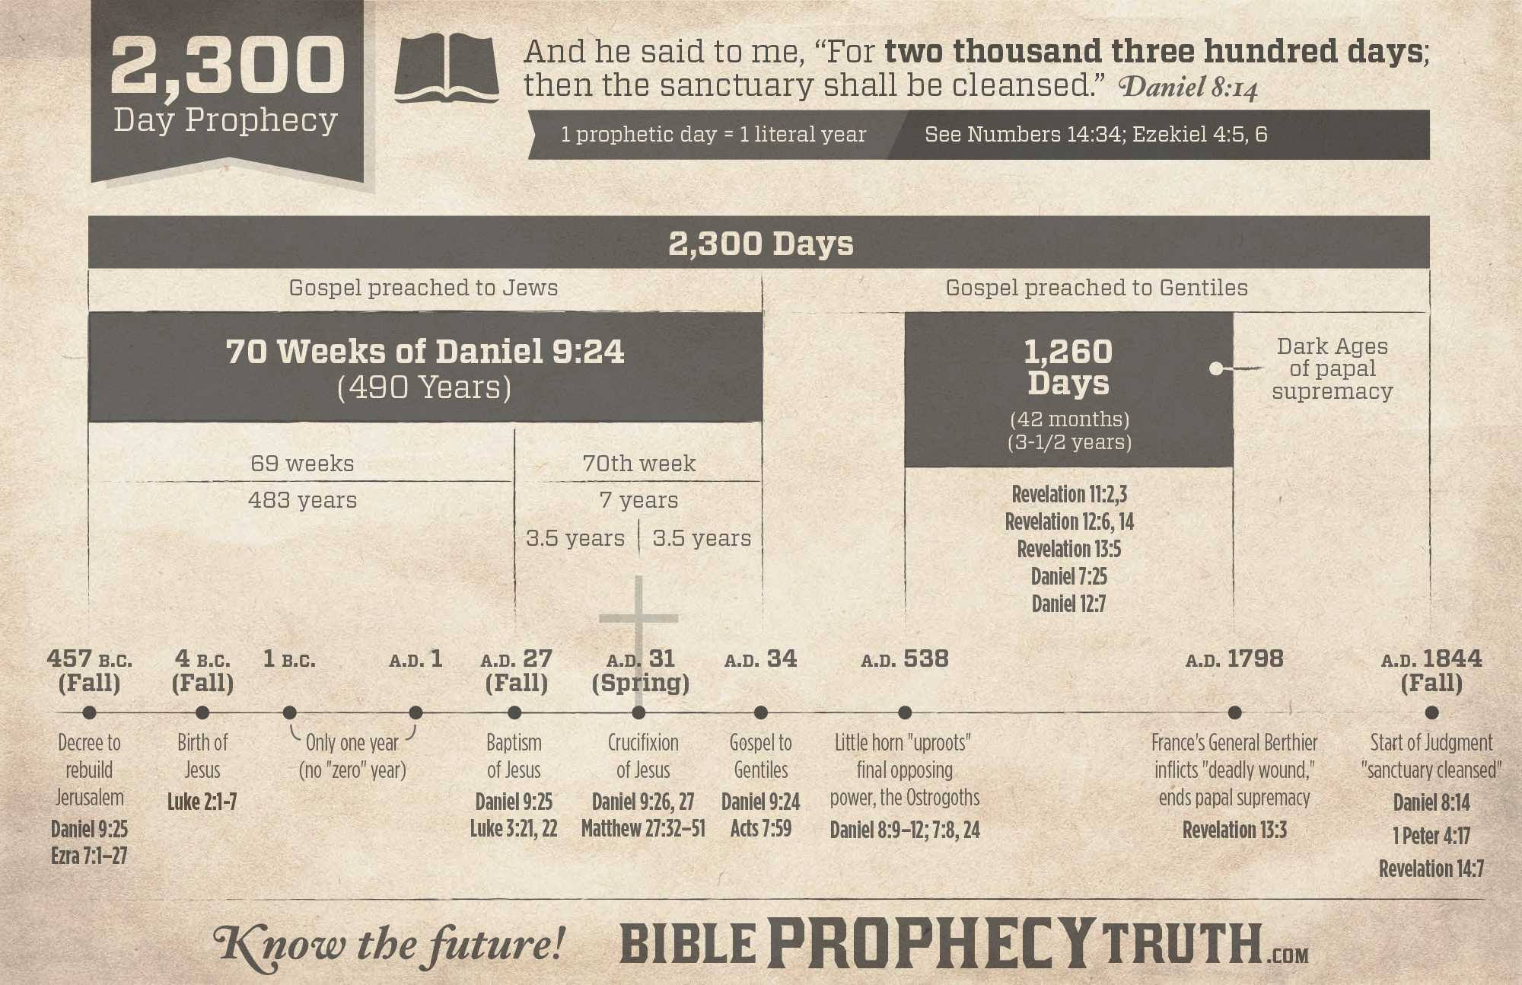

Slide 4
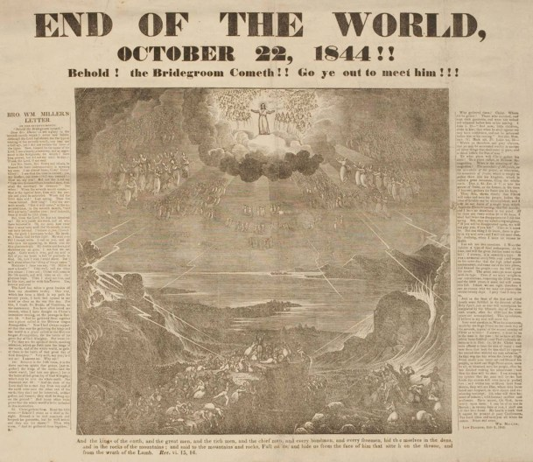

Slide 5
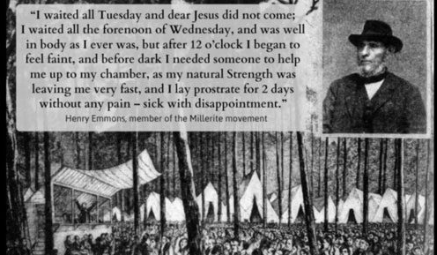

Slide 6
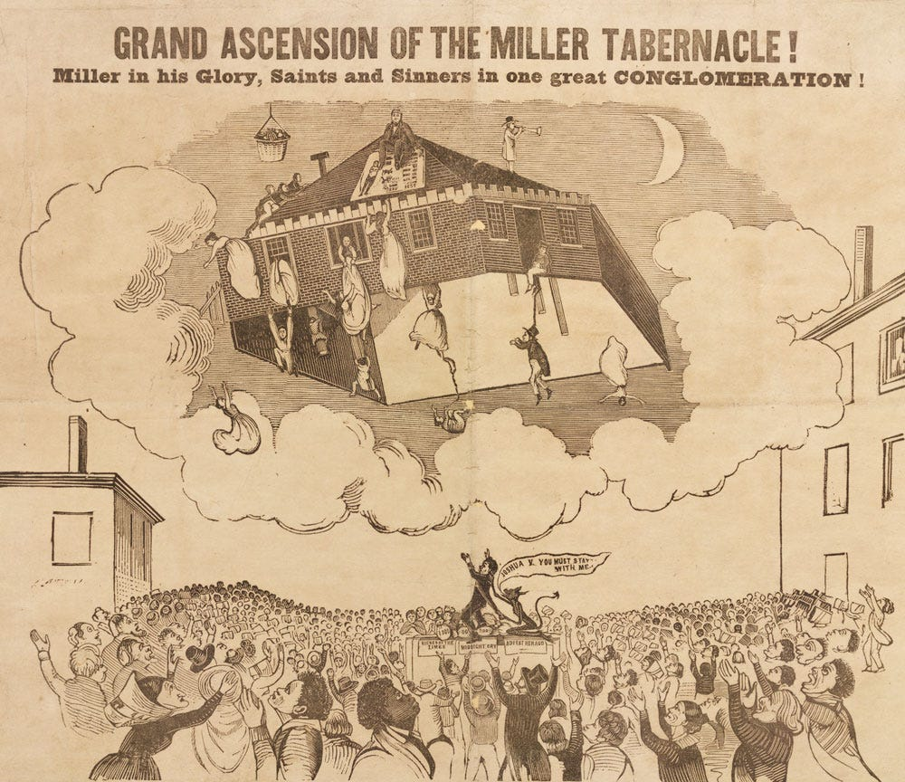

Slide 7
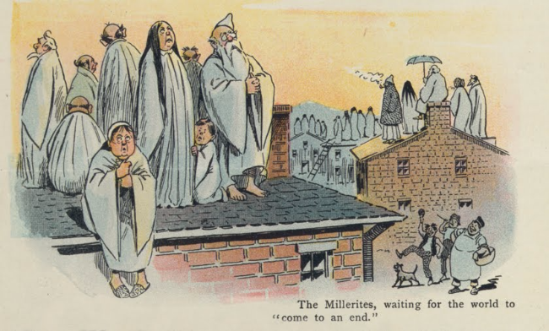

Slide 8
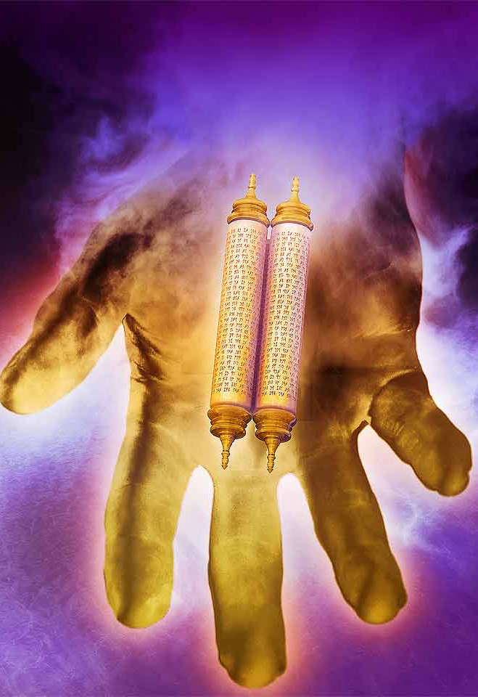
Revelation 10:8-11
8 And the voice which I heard from heaven spake unto me again, and said, Go and take the little book which is open in the hand of the angel which standeth upon the sea and upon the earth.
9 And I went unto the angel, and said unto him, Give me the little book. And he said unto me, Take it, and eat it up; and it shall make thy belly bitter, but it shall be in thy mouth sweet as honey.

Slide 9
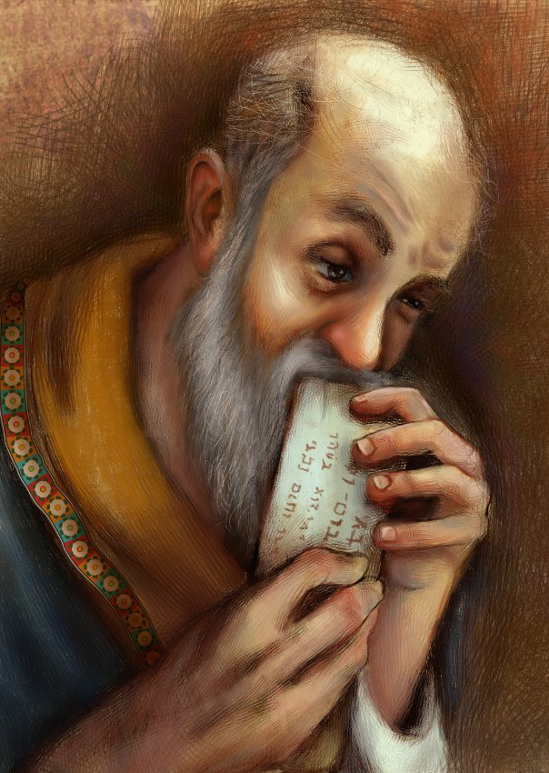
Revelation 10:10-11
10 And I took the little book out of the angel's hand, and ate it up; and it was in my mouth sweet as honey: and as soon as I had eaten it, my belly was bitter.
11 And he said unto me, Thou must prophesy again before many peoples, and nations, and tongues, and kings.

Slide 10
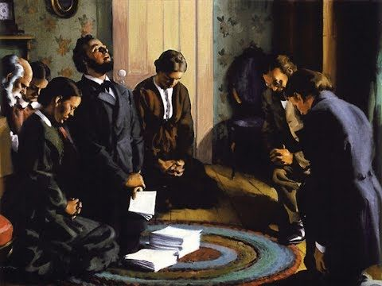
Daniel 8:14
And he said unto me, Unto two thousand and three hundred days; then shall the sanctuary be cleansed.

Slide 11
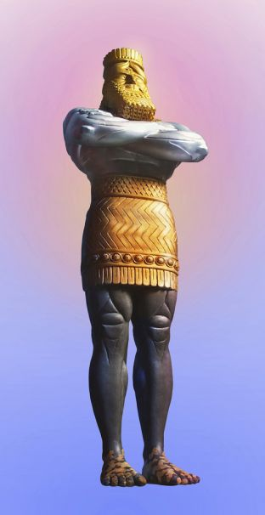
DANIEL 7
In the first year of Belshazzar king of Babylon Daniel had a dream and visions of his head upon his bed: then he wrote the dream, and told the sum of the matters.
2 Daniel spake and said, I saw in my vision by night, and, behold, the four winds of the heaven strove upon the great sea.
3 And four great beasts came up from the sea, diverse one from another.
4 The first was like a lion, and had eagle's wings: I beheld till the wings thereof were plucked, and it was lifted up from the earth, and made stand upon the feet as a man, and a man's heart was given to it.
DANIEL 8
In the third year of the reign of king Belshazzar a vision appeared unto me, even unto me Daniel, after that which appeared unto me at the first.
2 And I saw in a vision; and it came to pass, when I saw, that I was at Shushan in the palace, which is in the province of Elam; and I saw in a vision, and I was by the river of Ulai.

Slide 12
DANIEL 7
In the first year of Belshazzar king of Babylon Daniel had a dream and visions of his head upon his bed: then he wrote the dream, and told the sum of the matters.
2 Daniel spake and said, I saw in my vision by night, and, behold, the four winds of the heaven strove upon the great sea.
3 And four great beasts came up from the sea, diverse one from another.
4 The first was like a lion, and had eagle's wings: I beheld till the wings thereof were plucked, and it was lifted up from the earth, and made stand upon the feet as a man, and a man's heart was given to it.
DANIEL 8
In the third year of the reign of king Belshazzar a vision appeared unto me, even unto me Daniel, after that which appeared unto me at the first.
2 And I saw in a vision; and it came to pass, when I saw, that I was at Shushan in the palace, which is in the province of Elam; and I saw in a vision, and I was by the river of Ulai.
Daniel 8…
Is written in Hebrew
Skips the kingdom of Babylon which is shortly to be overthrown (3rd yr of Belshazzar)
Features Sanctuary animals
Daniel 7…
Is written in Aramaic
Follows the outline of the image in Daniel 2 (also written in Aramaic)
Features “unclean” animals

Slide 13
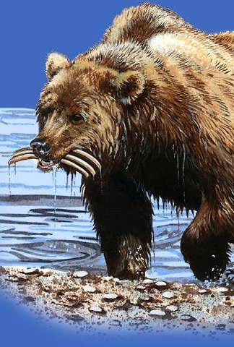
DANIEL 7
5 And behold another beast, a second, like to a bear, and it raised up itself on one side, and it had three ribs in the mouth of it between the teeth of it: and they said thus unto it, Arise, devour much flesh.
DANIEL 8
3 Then I lifted up mine eyes, and saw, and, behold, there stood before the river a ram which had two horns: and the two horns were high; but one was higher than the other, and the higher came up last.
4 I saw the ram pushing westward, and northward, and southward; so that no beasts might stand before him, neither was there any that could deliver out of his hand; but he did according to his will, and became great.

Slide 14
DANIEL 7
5 And behold another beast, a second, like to a bear, and it raised up itself on one side, and it had three ribs in the mouth of it between the teeth of it: and they said thus unto it, Arise, devour much flesh.
DANIEL 8
3 Then I lifted up mine eyes, and saw, and, behold, there stood before the river a ram which had two horns: and the two horns were high; but one was higher than the other, and the higher came up last.
4 I saw the ram pushing westward, and northward, and southward; so that no beasts might stand before him, neither was there any that could deliver out of his hand; but he did according to his will, and became great.
MEDO-PERSIA
Identified in Dan. 8:20

Slide 15
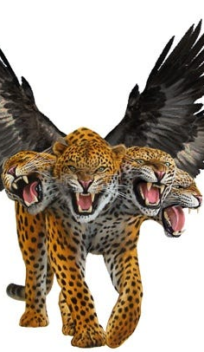
DANIEL 7
6 After this I beheld, and lo another, like a leopard, which had upon the back of it four wings of a fowl; the beast had also four heads; and dominion was given to it.
DANIEL 8
5 And as I was considering, behold, an he goat came from the west on the face of the whole earth, and touched not the ground: and the goat had a notable horn between his eyes.
6 And he came to the ram that had two horns, which I had seen standing before the river, and ran unto him in the fury of his power.
7 And I saw him come close unto the ram, and he was moved with choler against him, and smote the ram, and brake his two horns: and there was no power in the ram to stand before him, but he cast him down to the ground, and stamped upon him: and there was none that could deliver the ram out of his hand.
8 Therefore the he goat waxed very great: and when he was strong, the great horn was broken; and for it came up four notable ones toward the four winds of heaven.

Slide 16
DANIEL 7
6 After this I beheld, and lo another, like a leopard, which had upon the back of it four wings of a fowl; the beast had also four heads; and dominion was given to it.
DANIEL 8
5 And as I was considering, behold, an he goat came from the west on the face of the whole earth, and touched not the ground: and the goat had a notable horn between his eyes.
6 And he came to the ram that had two horns, which I had seen standing before the river, and ran unto him in the fury of his power.
7 And I saw him come close unto the ram, and he was moved with choler against him, and smote the ram, and brake his two horns: and there was no power in the ram to stand before him, but he cast him down to the ground, and stamped upon him: and there was none that could deliver the ram out of his hand.
8 Therefore the he goat waxed very great: and when he was strong, the great horn was broken; and for it came up four notable ones toward the four winds of heaven.
Grecia
Identified in Dan. 8:21

Slide 17
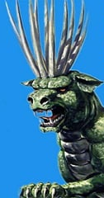
DANIEL 7
7 After this I saw in the night visions, and behold a fourth beast, dreadful and terrible, and strong exceedingly; and it had great iron teeth: it devoured and brake in pieces, and stamped the residue with the feet of it: and it was diverse from all the beasts that were before it; and it had ten horns.
DANIEL 8
9 And out of one of them came forth a little horn, which waxed exceeding great, toward the south, and toward the east, and toward the pleasant land.

Slide 18
DANIEL 7
7 After this I saw in the night visions, and behold a fourth beast, dreadful and terrible, and strong exceedingly; and it had great iron teeth: it devoured and brake in pieces, and stamped the residue with the feet of it: and it was diverse from all the beasts that were before it; and it had ten horns.
DANIEL 8
9 And out of one of them came forth a little horn, which waxed exceeding great, toward the south, and toward the east, and toward the pleasant land.
Rome
Identified by Dan. 2:40, 8:23

Slide 19
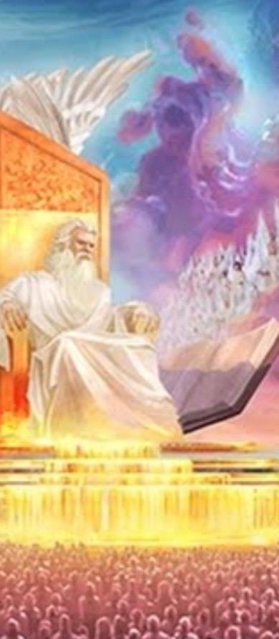
DANIEL 7
9 I beheld till the thrones were cast down, and the Ancient of days did sit, whose garment was white as snow, and the hair of his head like the pure wool: his throne was like the fiery flame, and his wheels as burning fire.
10 A fiery stream issued and came forth from before him: thousand thousands ministered unto him, and ten thousand times ten thousand stood before him: the judgment was set, and the books were opened.
11 I beheld then because of the voice of the great words which the horn spake: I beheld even till the beast was slain, and his body destroyed, and given to the burning flame.
DANIEL 8
13 Then I heard one saint speaking, and another saint said unto that certain saint which spake, How long shall be the vision concerning the daily sacrifice, and the transgression of desolation, to give both the sanctuary and the host to be trodden under foot?
14 And he said unto me, Unto two thousand and three hundred days; then shall the sanctuary be cleansed.

Slide 20
Daniel 8:14
And he said unto me, Unto two thousand and three hundred days; then shall the sanctuary be cleansed.

Slide 21
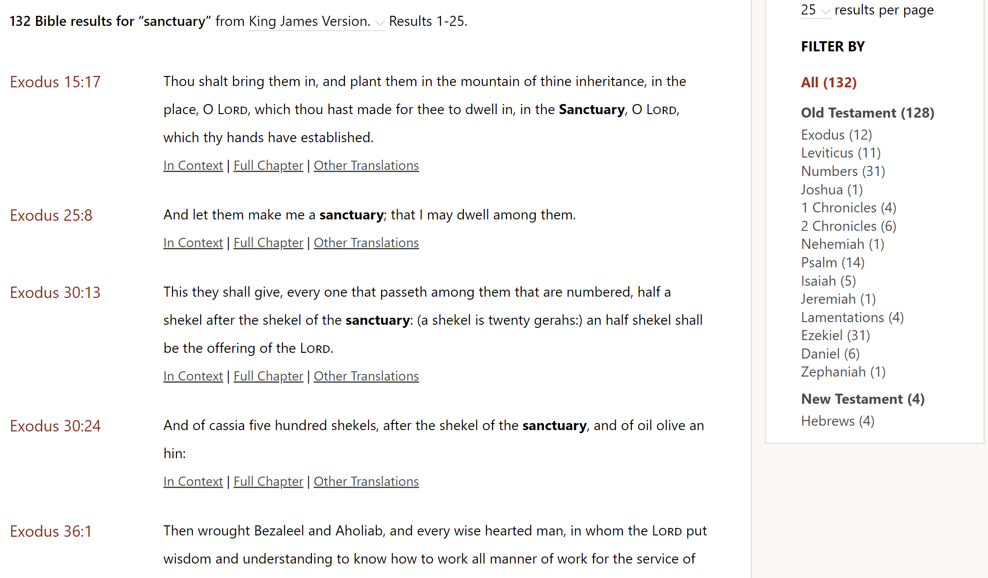

Slide 22


Slide 23
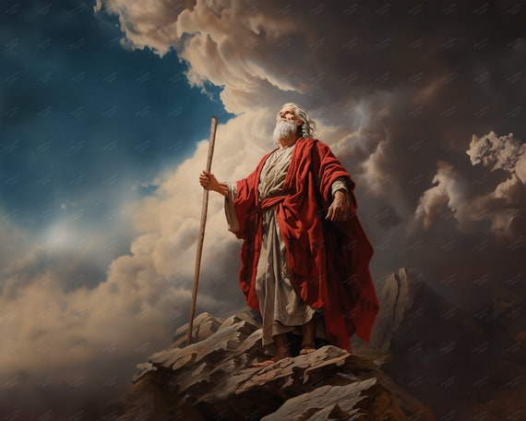
Exodus 25:8-9, 40
8 And let them make me a sanctuary; that I may dwell among them.
9 According to all that I shew thee, after the pattern of the tabernacle, and the pattern of all the instruments thereof, even so shall ye make it.

Slide 24
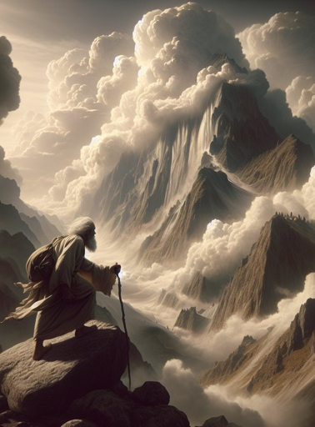
Exodus 25:40
….
40 And look that thou make them after their pattern, which was shewed thee in the mount.

Slide 25
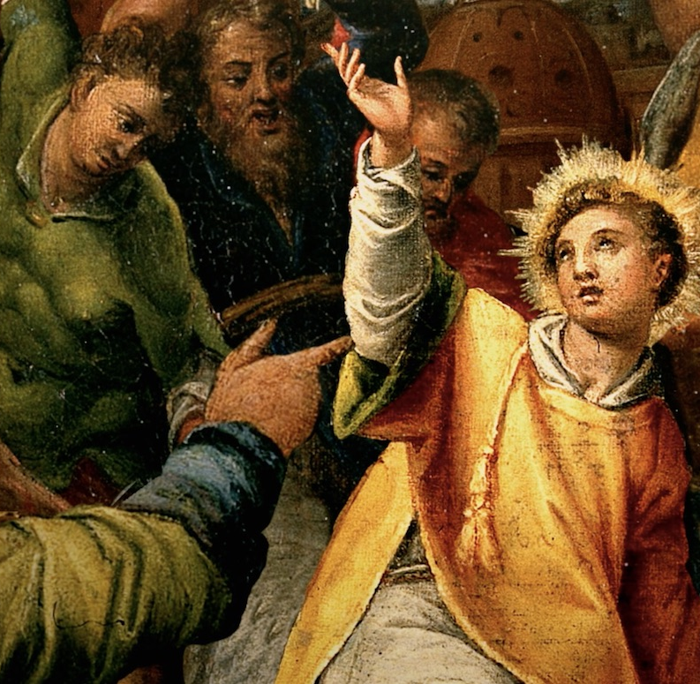
Acts 7:44
44 Our fathers had the tabernacle of witness in the wilderness, as he had appointed, speaking unto Moses, that he should make it according to the fashion that he had seen.

Slide 26
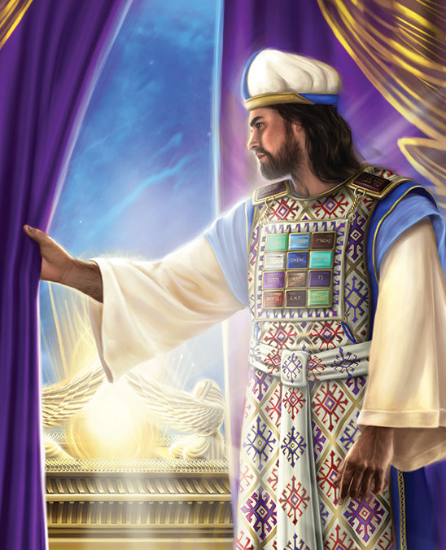
Hebrews 8:1-6
Now of the things which we have spoken this is the sum: We have such an high priest, who is set on the right hand of the throne of the Majesty in the heavens;
2 A minister of the sanctuary, and of the true tabernacle, which the Lord pitched, and not man.

Slide 27
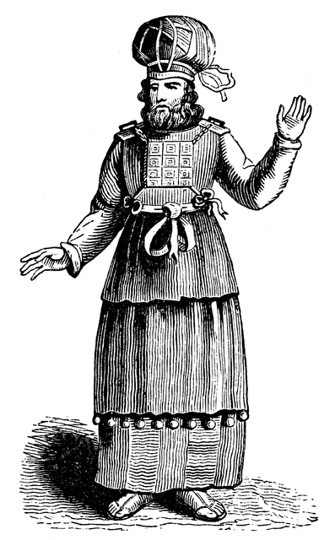
Hebrews 8:3-6
3 For every high priest is ordained to offer gifts and sacrifices: wherefore it is of necessity that this man have somewhat also to offer.
4 For if he were on earth, he should not be a priest, seeing that there are priests that offer gifts according to the law:

Slide 28
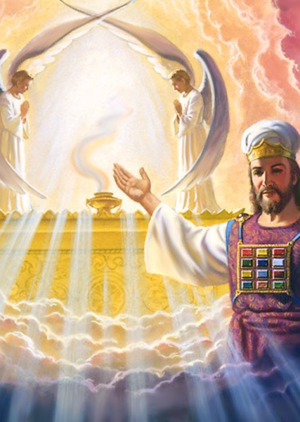
Hebrews 8:5-6
5 Who serve unto the example and shadow of heavenly things, as Moses was admonished of God when he was about to make the tabernacle: for, See, saith he, that thou make all things according to the pattern shewed to thee in the mount.
6 But now hath he obtained a more excellent ministry, by how much also he is the mediator of a better covenant, which was established upon better promises.

Slide 29
Patriarchs and Prophets P. 343
“God Himself gave to Moses the plan of that structure, with particular directions as to its size and form, the materials to be employed, and every article of furniture which it was to contain. The holy places made with hands were to be “figures of the true,” “patterns of things in the heavens” (Hebrews 9:24, 23)—a miniature representation of the heavenly temple ….God presented before Moses in the mount a view of the heavenly sanctuary, and commanded him to make all things according to the pattern shown him.”

Slide 30
Daniel 8:14
Two sanctuaries mentioned in the Bible:
The Sanctuary in the Wilderness, the building of which was supervised by Moses, and
The Heavenly Sanctuary of which the Sanctuary in the Wilderness was just a model.
And he said unto me, Unto two thousand and three hundred days; then shall the sanctuary be cleansed.

Slide 32
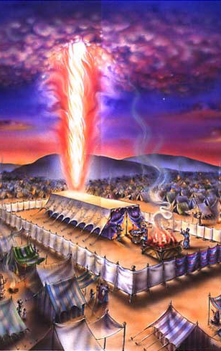
The Great Controversy p. 417
“The question, What is the sanctuary? is clearly answered in the Scriptures. The term “sanctuary,” as used in the Bible, refers, first, to the tabernacle built by Moses, as a pattern of heavenly things; and, secondly, to the “true tabernacle” in heaven, to which the earthly sanctuary pointed. At the death of Christ the typical service ended. The “true tabernacle” in heaven is the sanctuary of the new covenant.”

Slide 33
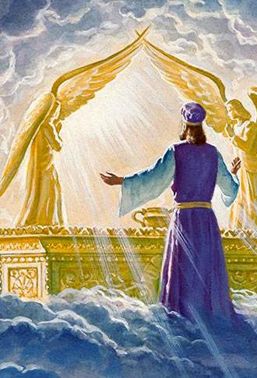
The Great Controversy p. 417
“At the termination of the 2300 days, in 1844, there had been no sanctuary on earth for many centuries. Thus the prophecy, “Unto two thousand and three hundred days; then shall the sanctuary be cleansed,” unquestionably points to the sanctuary in heaven.”

Slide 34
Daniel 8:14
If we accept that this verse refers to the HEAVENLY SANCTUARY,
then we need to ask what it means for that sanctuary to be cleansed! How is it even dirty?
And he said unto me, Unto two thousand and three hundred days; then shall the sanctuary be cleansed.

Slide 35

The Great Controversy P. 417
The cleansing, both in the typical and in the real service, must be accomplished with blood: in the former, with the blood of animals; in the latter, with the blood of Christ. Paul states, as the reason why this cleansing must be performed with blood, that without shedding of blood is no remission. Remission, or putting away of sin, is the work to be accomplished.

Slide 36
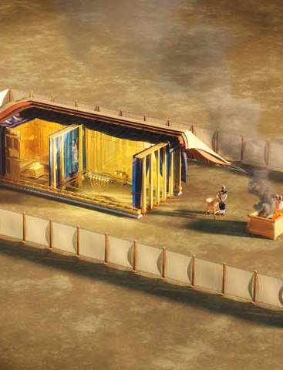
The Great Controversy P. 417
But how could there be sin connected with the sanctuary, either in heaven or upon the earth? This may be learned by reference to the symbolic service; for the priests who officiated on earth, served “unto the example and shadow of heavenly things.” Hebrews 8:5.

Slide 37
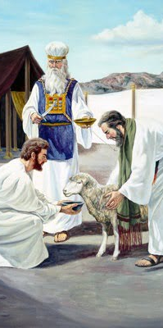
The Great Controversy P. 418
Day by day the repentant sinner brought his offering to the door of the tabernacle and, placing his hand upon the victim's head, confessed his sins, thus in figure transferring them from himself to the innocent sacrifice. The animal was then slain. The broken law of God demanded the life of the transgressor.

Slide 38
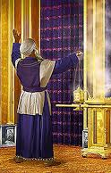
The Great Controversy P. 418
The blood, representing the forfeited life of the sinner, whose guilt the victim bore, was carried by the priest into the holy place and sprinkled before the veil, behind which was the ark containing the law that the sinner had transgressed. By this ceremony the sin was, through the blood, transferred in figure to the sanctuary.

Slide 39
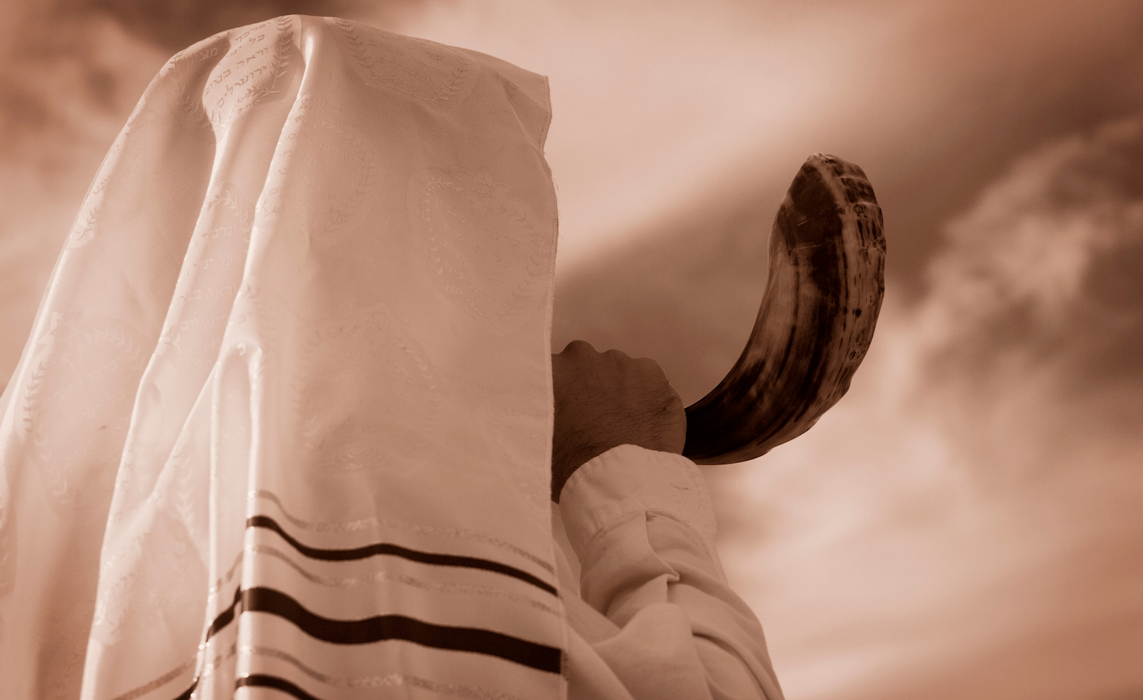
The Great Controversy P. 418-419
Such was the work that went on, day by day, throughout the year. The sins of Israel were thus transferred to the sanctuary, and a special work became necessary for their removal… Once a year, on the great Day of Atonement, the priest entered the most holy place for the cleansing of the sanctuary. The work there performed completed the yearly round of ministration.

Slide 40
Daniel 8:14
So the sins of God’s people are transferred to the sacrifice (Jesus) and then to the Sanctuary… which then requires cleansing. Sounds like a work of judgement, as Daniel 7 suggests!
We turn once again to the “model” Sanctuary…
And he said unto me, Unto two thousand and three hundred days; then shall the sanctuary be cleansed.

Slide 41
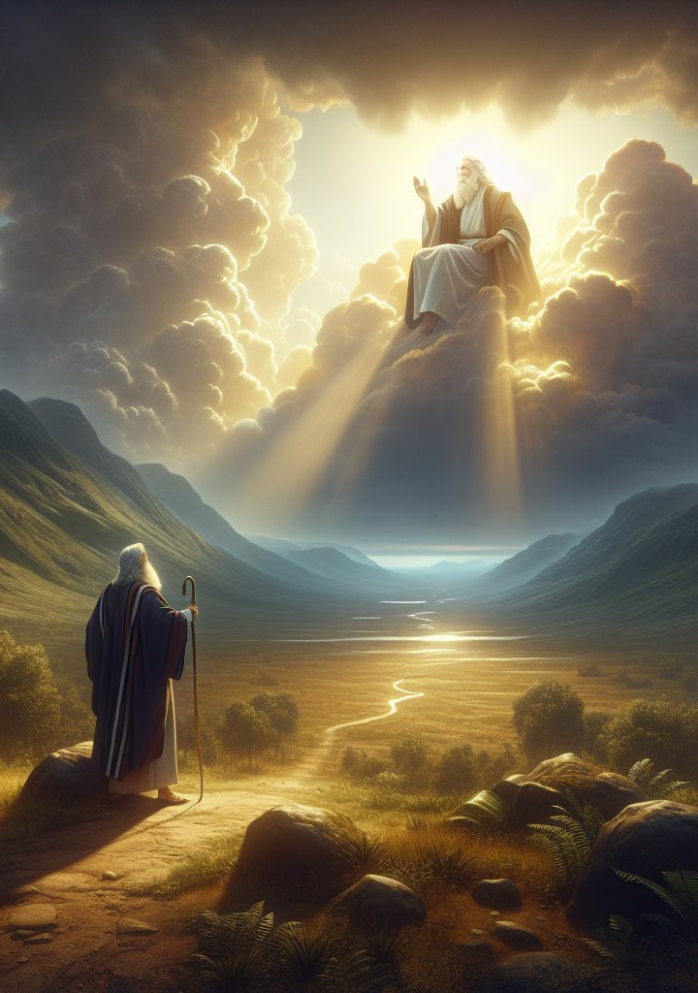
Leviticus 23:26-32
26 And the Lord spake unto Moses, saying,
27 Also on the tenth day of this seventh month there shall be a day of atonement: it shall be an holy convocation unto you; and ye shall afflict your souls, and offer an offering made by fire unto the Lord.
28 And ye shall do no work in that same day: for it is a day of atonement, to make an atonement for you before the Lord your God.

Slide 42
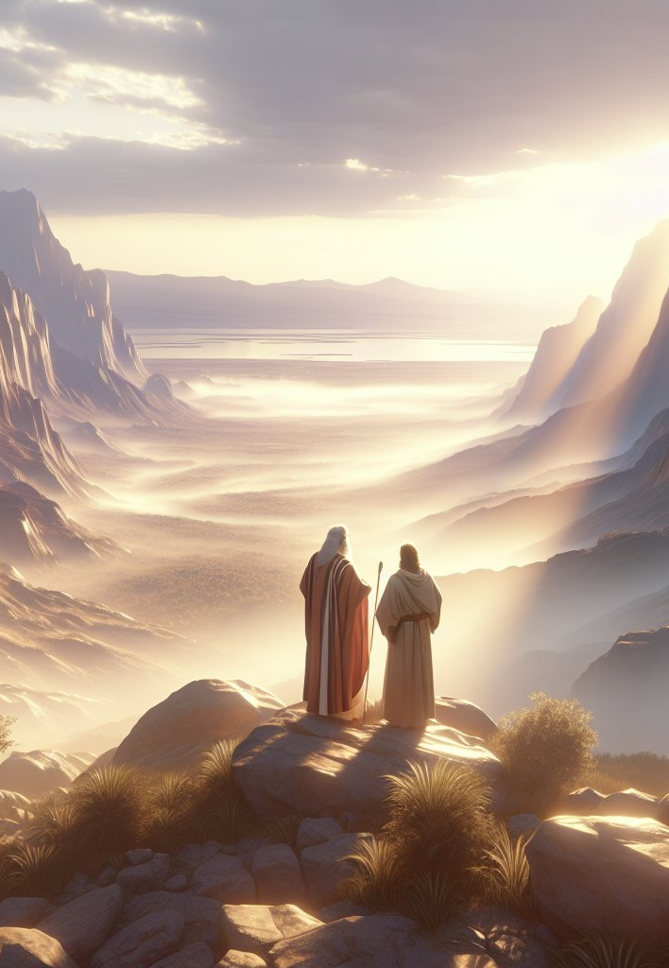
Leviticus 23:29-32
29 For whatsoever soul it be that shall not be afflicted in that same day, he shall be cut off from among his people.
30 And whatsoever soul it be that doeth any work in that same day, the same soul will I destroy from among his people.

Slide 43
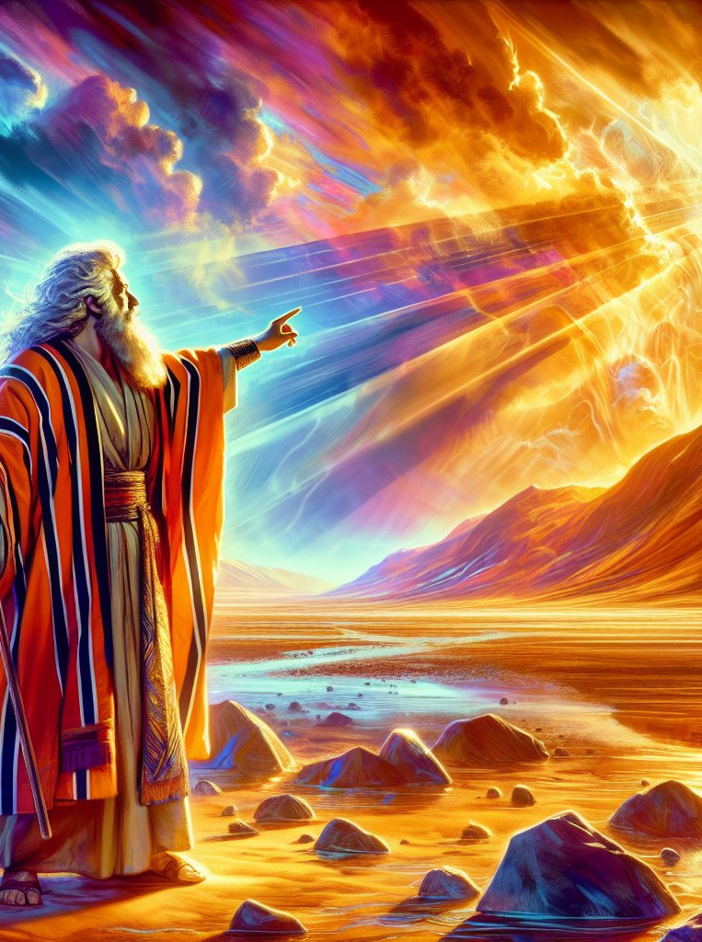
Leviticus 23:31-32
31 Ye shall do no manner of work: it shall be a statute for ever throughout your generations in all your dwellings.
32 It shall be unto you a sabbath of rest, and ye shall afflict your souls: in the ninth day of the month at even, from even unto even, shall ye celebrate your sabbath.

Slide 44
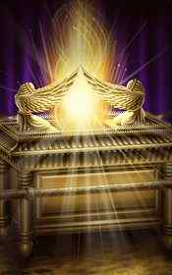
Leviticus 16:2-24
2 And the Lord said unto Moses, Speak unto Aaron thy brother, that he come not at all times into the holy place within the vail before the mercy seat, which is upon the ark; that he die not: for I will appear in the cloud upon the mercy seat.
3 Thus shall Aaron come into the holy place: with a young bullock for a sin offering, and a ram for a burnt offering.

Slide 45
Leviticus 16:2-24
Throughout this chapter Moses calls the second apartment, what we call the Most Holy Place or Holy of Holies, “the holy place”; while he refers to the Holy Place, or the first apartment, as the “tabernacle of the congregation.”
2 And the Lord said unto Moses, Speak unto Aaron thy brother, that he come not at all times into the holy place within the vail before the mercy seat, which is upon the ark; that he die not: for I will appear in the cloud upon the mercy seat.
3 Thus shall Aaron come into the holy place: with a young bullock for a sin offering, and a ram for a burnt offering.

Slide 46

Seventh-Day Adventist Bible Commentary Vol. 1 p. 774
On the Day of Atonement the high priest himself officiated in all parts of the service, assisted by the other priests. He conducted the daily morning and evening services arrayed in golden garments.
These costly garments not only were adorned with gold and precious stones (Ex. 28:13-36) but were also embroidered with the colors of the sanctuary and with fine thread of pure gold (Ex. 28:4-6). Clad thus, the high priest represented Christ in His divine glory as the Son of God.

Slide 47
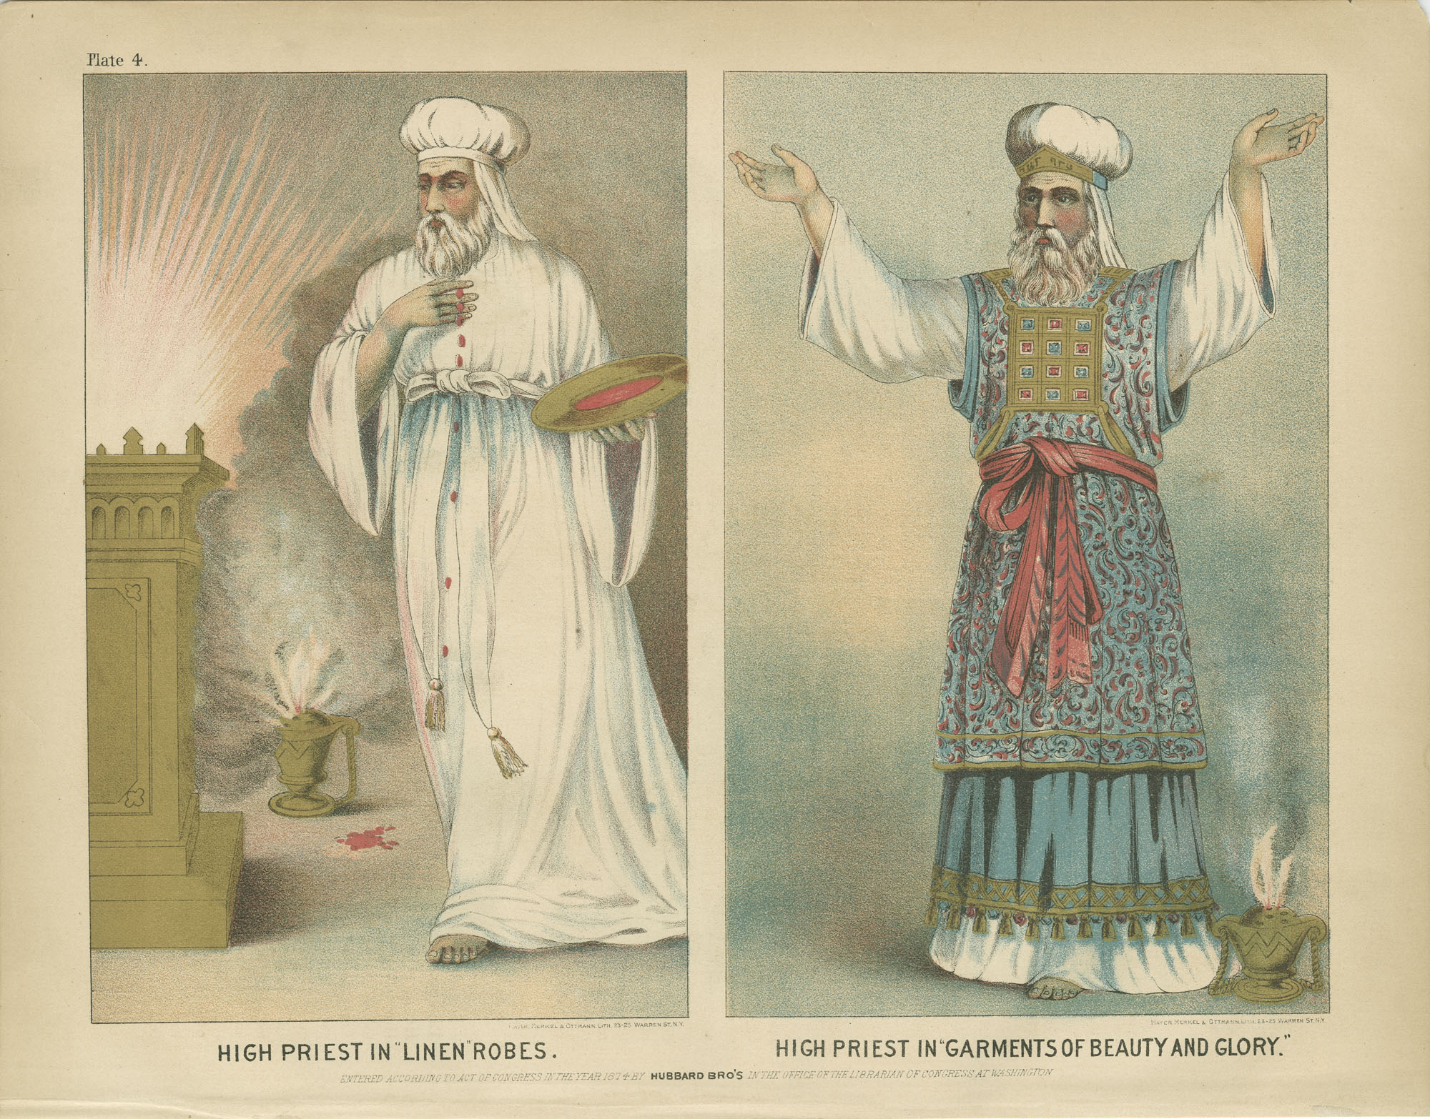

Slide 48
Seventh-Day Adventist Bible Commentary Vol. 1 p. 774
At the first light of dawn, according to the Talmud, he removed his personal clothing and attired himself in the golden garments; in these he conducted the regular morning service. This completed, he removed the golden garments and put on the “holy garments” for the special services of the day (v. 4). Whereas the high priest clad in his golden garments represented Christ to the people, in his “holy garments” he typified Christ in His mediatorial capacity as a representative of the people before God (GC 422).

Slide 49
Leviticus 16:3-24
3 Thus shall Aaron come into the holy place: with a young bullock for a sin offering, and a ram for a burnt offering.
4 He shall put on the holy linen coat, and he shall have the linen breeches upon his flesh, and shall be girded with a linen girdle, and with the linen mitre shall he be attired: these are holy garments; therefore shall he wash his flesh in water, and so put them on.

Slide 50
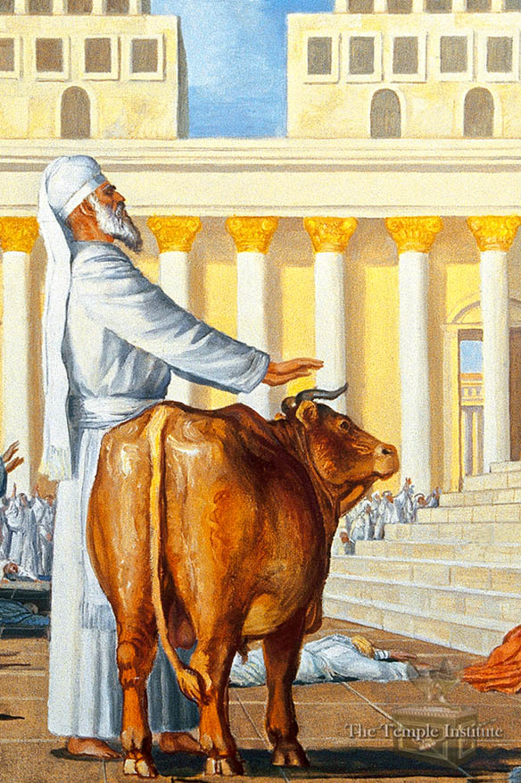
Leviticus 16:5-24
5 And he shall take of the congregation of the children of Israel two kids of the goats for a sin offering, and one ram for a burnt offering.
6 And Aaron shall offer his bullock of the sin offering, which is for himself, and make an atonement for himself, and for his house.

Slide 51
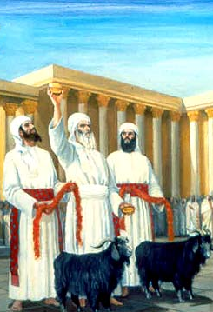
Leviticus 16:7-24
7 And he shall take the two goats, and present them before the Lord at the door of the tabernacle of the congregation.
8 And Aaron shall cast lots upon the two goats; one lot for the Lord, and the other lot for the scapegoat.
9 And Aaron shall bring the goat upon which the Lord's lot fell, and offer him for a sin offering.

Slide 52
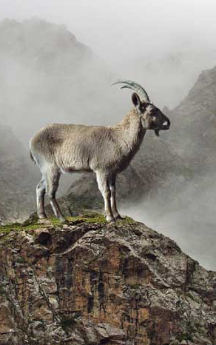
Leviticus 16:10-24
10 But the goat, on which the lot fell to be the scapegoat, shall be presented alive before the Lord, to make an atonement with him, and to let him go for a scapegoat into the wilderness.
11 And Aaron shall bring the bullock of the sin offering, which is for himself, and shall make an atonement for himself, and for his house, and shall kill the bullock of the sin offering which is for himself:

Slide 53
Some theologians think both goats are symbolic of Christ, and that they represent two phases of His atoning work. Not a few, however, believe that they represent two opposing forces, and that as the one is for the Lord, the other is for Satan. Most versions leave the Hebrew word for scapegoat, ‘azazel, untranslated, since there is no unanimity of opinion in regard to its meaning. Many modern scholars hold, with the Jews, that Azazel denotes a personal, wicked, superhuman spirit, and nearly all agree that its root meaning is, “one who removes,” “a remover,” specifically, one who removes “by a series of acts.” As one goat is for the Lord, a personal Being, so the other goat must also be for a personal being; and as they are evidently antithetical, the most consistent view would be that Azazel stands in opposition to the Lord, and hence can be no other than Satan. --SDABC V. 1, p. 775

Slide 54
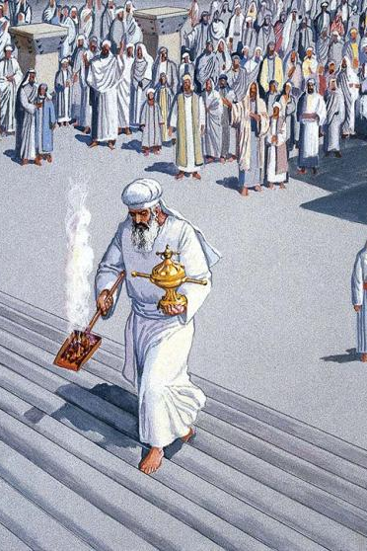
Leviticus 16:12-24
12 And he shall take a censer full of burning coals of fire from off the altar before the Lord, and his hands full of sweet incense beaten small, and bring it within the vail:
13 And he shall put the incense upon the fire before the Lord, that the cloud of the incense may cover the mercy seat that is upon the testimony, that he die not:

Slide 55
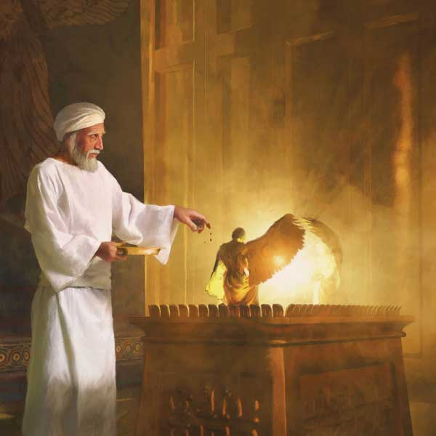
Leviticus 16:14-24
14 And he shall take of the blood of the bullock, and sprinkle it with his finger upon the mercy seat eastward; and before the mercy seat shall he sprinkle of the blood with his finger seven times.
15 Then shall he kill the goat of the sin offering, that is for the people, and bring his blood within the vail, and do with that blood as he did with the blood of the bullock, and sprinkle it upon the mercy seat, and before the mercy seat:

Slide 56
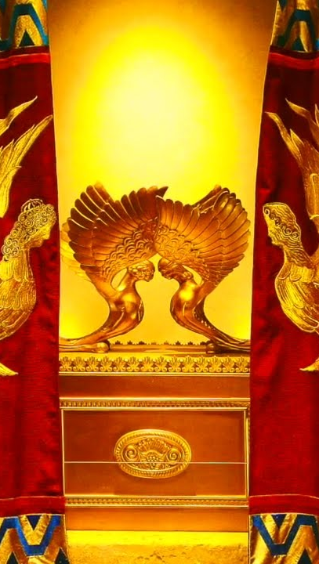
Leviticus 16:16-24
16 And he shall make an atonement for the holy place, because of the uncleanness of the children of Israel, and because of their transgressions in all their sins: and so shall he do for the tabernacle of the congregation, that remaineth among them in the midst of their uncleanness.
17 And there shall be no man in the tabernacle of the congregation when he goeth in to make an atonement in the holy place, until he come out, and have made an atonement for himself, and for his household, and for all the congregation of Israel.

Slide 57
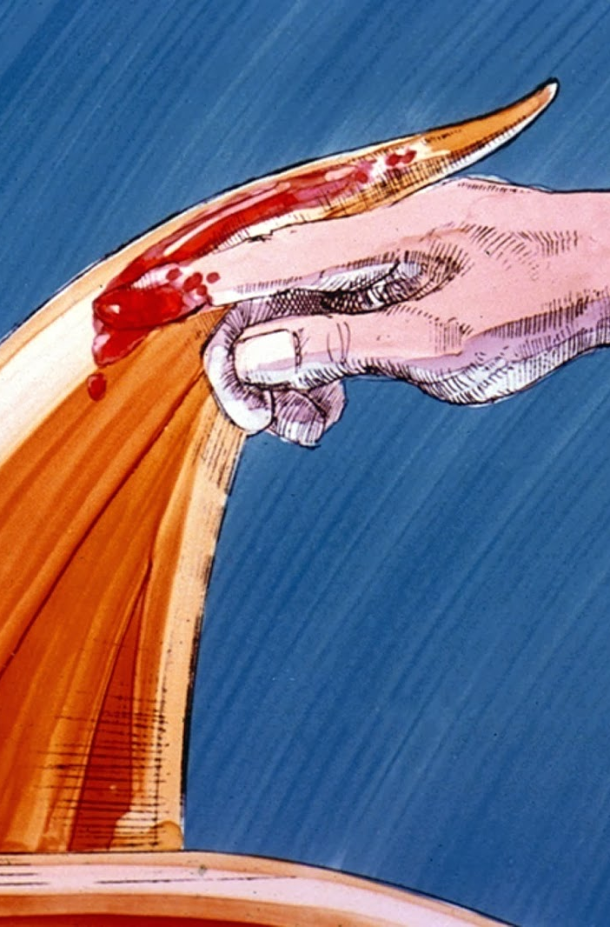
Leviticus 16:18-24
18 And he shall go out unto the altar that is before the Lord, and make an atonement for it; and shall take of the blood of the bullock, and of the blood of the goat, and put it upon the horns of the altar round about.
19 And he shall sprinkle of the blood upon it with his finger seven times, and cleanse it, and hallow it from the uncleanness of the children of Israel.

Slide 58
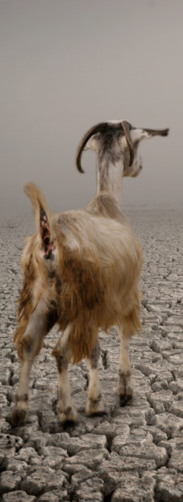
Leviticus 16:20-24
20 And when he hath made an end of reconciling the holy place, and the tabernacle of the congregation, and the altar, he shall bring the live goat:
21 And Aaron shall lay both his hands upon the head of the live goat, and confess over him all the iniquities of the children of Israel, and all their transgressions in all their sins, putting them upon the head of the goat, and shall send him away by the hand of a fit man into the wilderness:
22 And the goat shall bear upon him all their iniquities unto a land not inhabited: and he shall let go the goat in the wilderness.

Slide 59
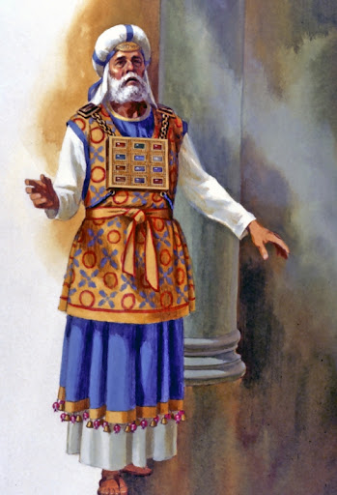
Leviticus 16:23-24
23 And Aaron shall come into the tabernacle of the congregation, and shall put off the linen garments, which he put on when he went into the holy place, and shall leave them there:
24 And he shall wash his flesh with water in the holy place, and put on his garments, and come forth, and offer his burnt offering, and the burnt offering of the people, and make an atonement for himself, and for the people.

Slide 60
Daniel 8:14
So what happened in 1844?
The anti-typical Day of Atonement, in which the sins of God’s people are erased, cleansed, and removed forever, began! This work involves a judgement of who, exactly, is included among God’s people.
And he said unto me, Unto two thousand and three hundred days; then shall the sanctuary be cleansed.

Slide 61
As anciently the sins of the people were by faith placed upon the sin offering and through its blood transferred, in figure, to the earthly sanctuary, so in the new covenant the sins of the repentant are by faith placed upon Christ and transferred, in fact, to the heavenly sanctuary. And as the typical cleansing of the earthly was accomplished by the removal of the sins by which it had been polluted, so the actual cleansing of the heavenly is to be accomplished by the removal, or blotting out, of the sins which are there recorded.
The Great Controversy, p. 421

Slide 62
But before this can be accomplished, there must be an examination of the books of record to determine who, through repentance of sin and faith in Christ, are entitled to the benefits of His atonement. The cleansing of the sanctuary therefore involves a work of investigation—a work of judgment. This work must be performed prior to the coming of Christ to redeem His people; for when He comes, His reward is with Him to give to every man according to his works. Revelation 22:12.
The Great Controversy, p. 421

Slide 63
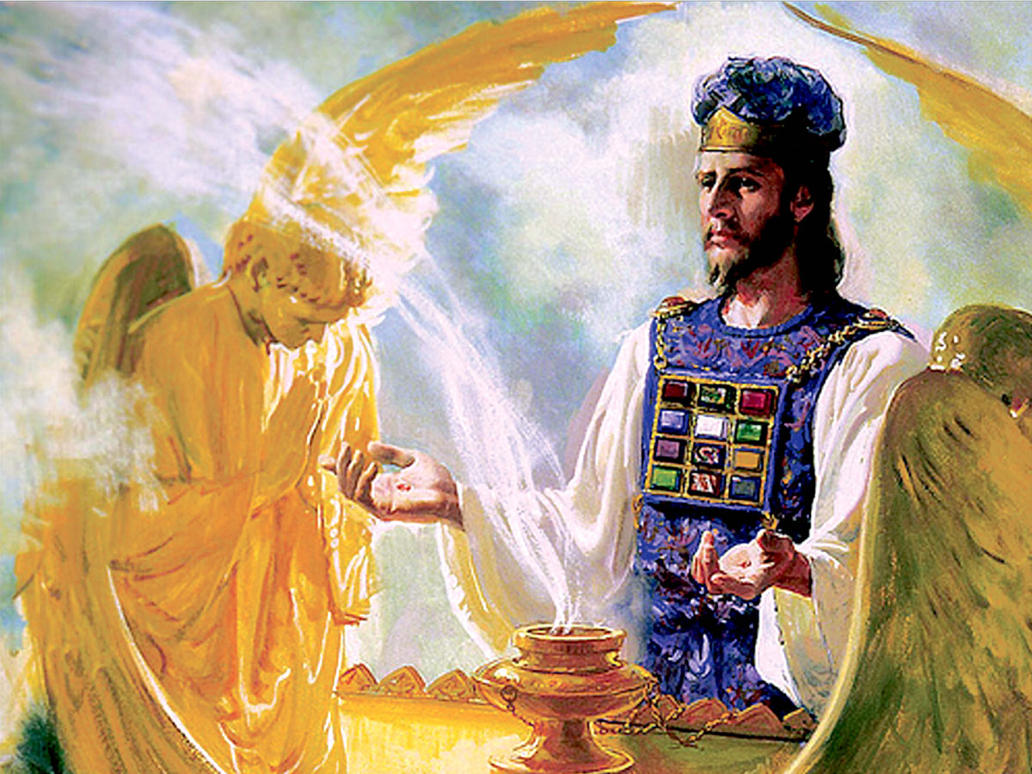
The Sanctuary Cleansed: Hebrews 8:1-2
8 Now of the things which we have spoken this is the sum: We have such an high priest, who is set on the right hand of the throne of the Majesty in the heavens;

Slide 64

The Sanctuary Cleansed: Hebrews 8:2
² A minister of the sanctuary, and of the true tabernacle, which the Lord pitched, and not man.

Slide 65
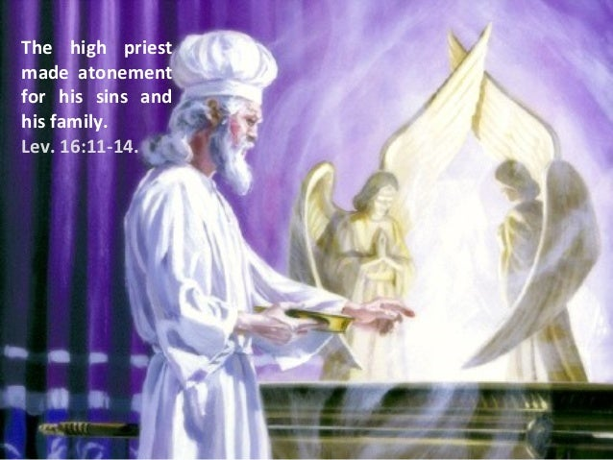
The Sanctuary Cleansed: Hebrews 9:11-12
¹¹ But Christ being come an high priest of good things to come, by a greater and more perfect tabernacle, not made with hands, that is to say, not of this building;

Slide 66
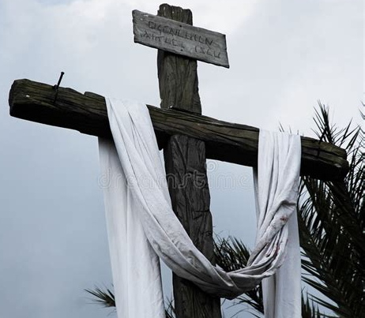
The Sanctuary Cleansed: Hebrews 9:12
¹² Neither by the blood of goats and calves, but by his own blood he entered in once into the holy place, having obtained eternal redemption for us.

Slide 67
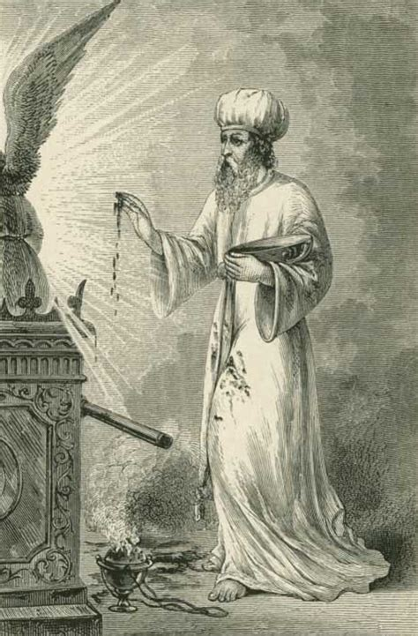
The Sanctuary Cleansed: Hebrews 9:23-26
²³ It was therefore necessary that the patterns of things in the heavens should be purified with these; but the heavenly things themselves with better sacrifices than these.

Slide 68
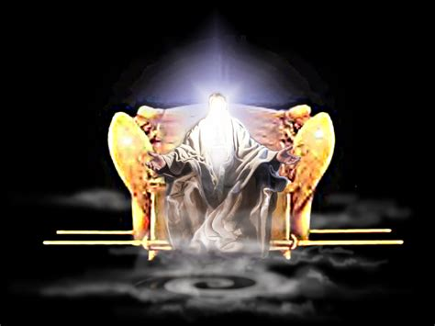
The Sanctuary Cleansed: Hebrews 9:24-26
²⁴ For Christ is not entered into the holy places made with hands, which are the figures of the true; but into heaven itself, now to appear in the presence of God for us:

Slide 69
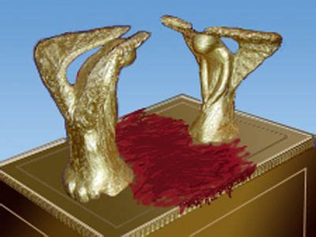
The Sanctuary Cleansed: Hebrews 9:25-26
²⁵ Nor yet that he should offer himself often, as the high priest entereth into the holy place every year with blood of others;

Slide 70
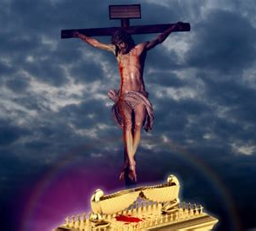
The Sanctuary Cleansed: Hebrews 9:26
²⁶ For then must he often have suffered since the foundation of the world: but now once in the end of the world hath he appeared to put away sin by the sacrifice of himself.

Slide 71

After the Great Disappointment

Slide 72

Thank You!
Happy Sabbath!!

